Slide 1
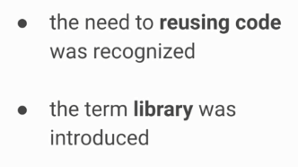
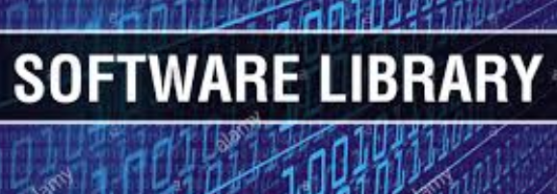
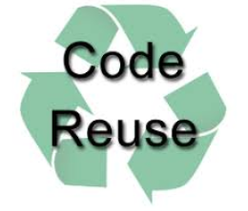
History of API
1950

Slide 2
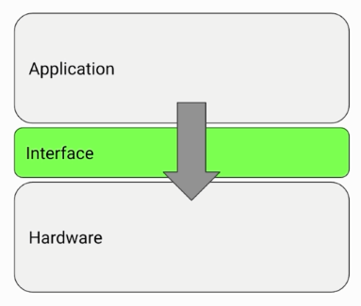
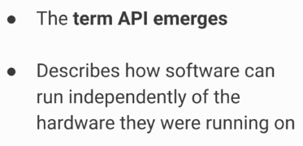
History of API
1970

Slide 3
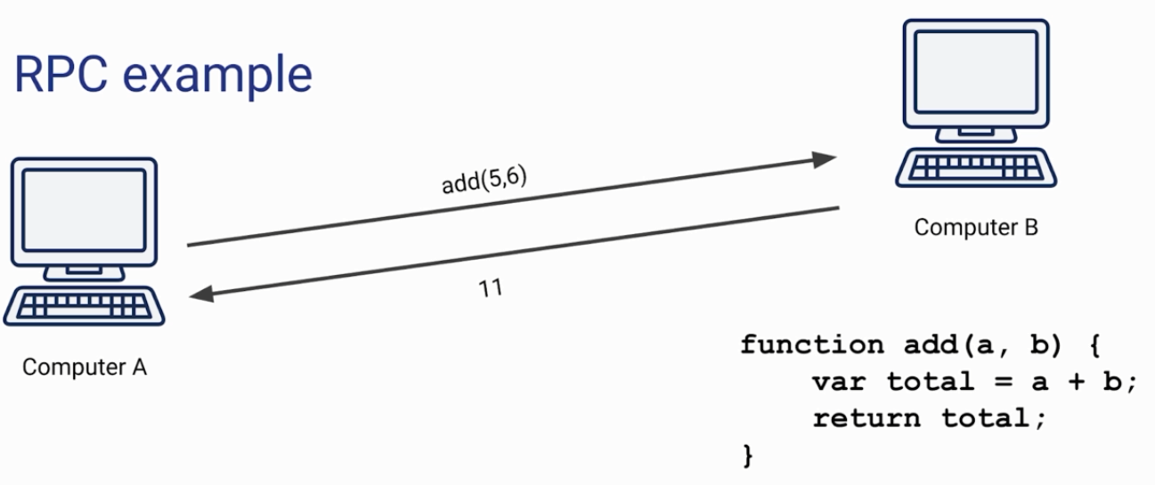

1980
History of API
Remote Procedure Call (RPC) is a protocol that one program can use to request a service from a program located in another computer on a network without having to understand the network's details. ... A procedure call is also sometimes known as a function call or a subroutine call. RPC uses the client-server model.

Slide 4
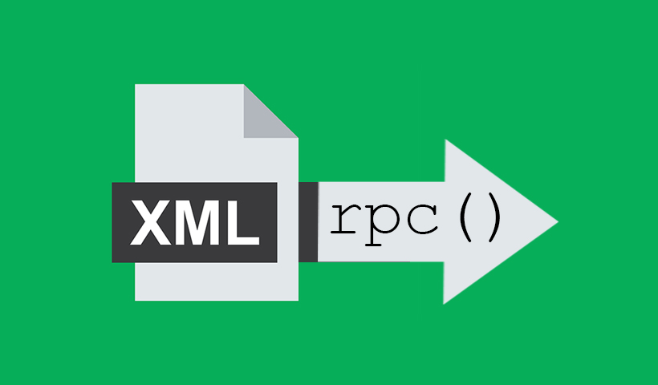
History of API
1998

Slide 5
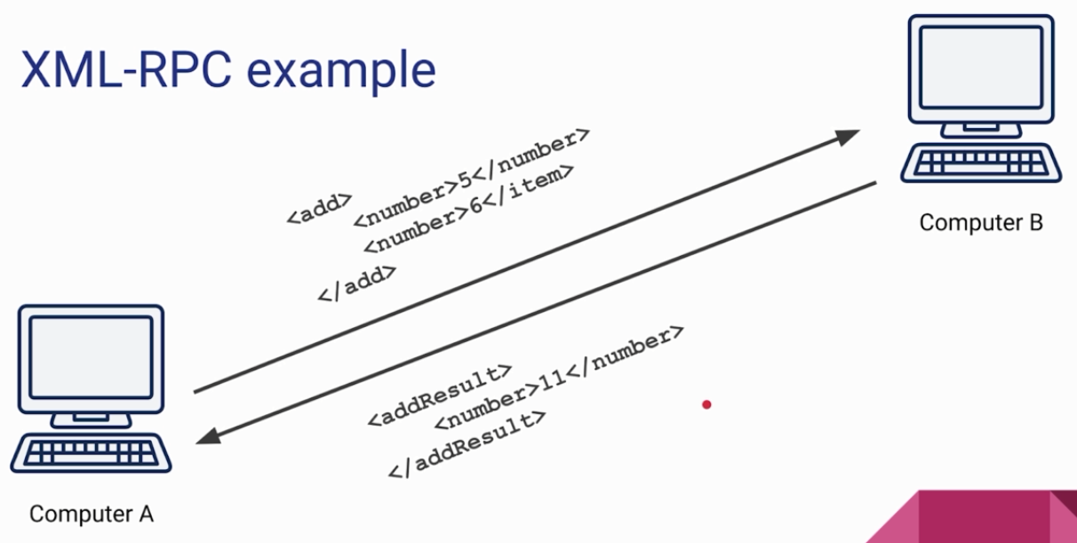
History of API

Slide 6
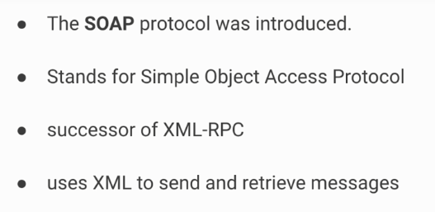
History of API
1999

Slide 7
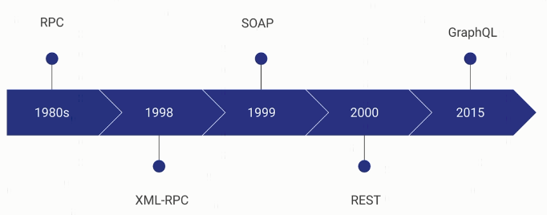
History of API

Slide 8
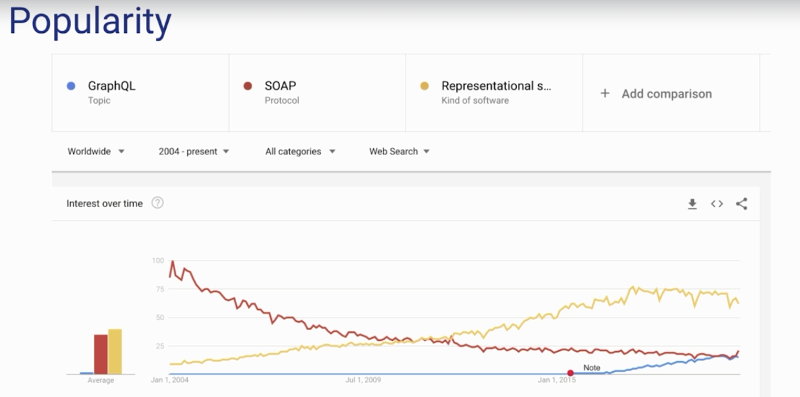
History of API

